Slide 1
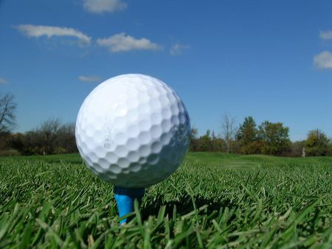

19th Annual
Air Defense Artillery Association (ADAA)
Best Organizational / Company (Team) Challenge Golf Tournament
27 September 2024
The Links at Redstone
Four Person Scramble & Shotgun Start at 8:30 AM
POC: Jon Randel at 256 585 4021 (M) & golf@huntsvilleadaa.org
7:15-8:15 AM: Check In, Purchase Mulligans, Breakfast, Free Range Balls
8:15- 8:30 Shotgun Start Golf; Then Lunch, Prizes, Awards & More
13:00 PM: Non-Golfing ADAA members join us for free Social at the Links
$100 per Person & $400 per Team; w/ Lunch, Greens Fees, Cart & Social
Two Mulligans may be purchased for $20 (max is 2 Mulligans per person)
Door Prizes raffled with Mulligan 2 tickets; Skill Prizes (2-Closest-to-the-Pin holes and 2-longest drives holes); Traveling Trophy Awarded to Best Team
Corporate Sponsorships with logo signage posters Available for $200
Registration & Payment w/ your Team’s Name, Player Names Entries:
https://app.tickettailor.com/events/huntsvilleairdefenseartilleryassociation/1354037

Slide 2
Rules
This will be a 4-person Scramble format tournament
Two Mulligans = One Tickets may be purchased for $20 (max is 2 Mulligans per person for 1 Ticket)
Men will hit from the WHITE Tees (over 62 may hit from the White)
Women will hit from the Gold Tees
Normal Scramble rules apply. All players hit from the designated Tee and the team selects the best shot. All team members pick up their balls and play from the best ball location within one (1) Club length but no closer to the hole. The shot must be played from the same cut of grass. You may NOT use the club length to get out of a hazard or deep rough.
Two (2) Putt Rule – A maximum of 2 putts is possible, so if you miss the first putt, pick up and keep moving.
There are NO provisional or “gimme” shots. (You must use a Mulligans)
Longest drive MUST be in the fairway, Closest to the pin MUST be on the green.
6. The event will be flighted after the round based on number of teams.
7. Golf is a game of Honor, enjoy it, and if not addressed, USGA rules apply.
Missing Player Rules (less than 4 golfers)
Team must play the 4th shot by ROTATING among the available players.

Slide 3


ADAA Trophy
Rules for Competition
NOTE – All Golfers and Teams regardless of make-up can compete for the skill and door prizes, but to be eligible for the ADAA Trophy, your team must comply with these rules:
1. ALL 4 players must be from the same Organization or Company
2. Government/Contractor mixed teams are acceptable, if all players support the same Organization or Project Office.
  Example #1: 2 players are Lockheed Martin employees supporting the IFMC or SHIELD Project Office, and 2 players are Government employees in the same project office.
    The name of the Organization Competing for the trophy is the IFMC or SHIELD Project Office because that is the common element.
  Example #2: 2 players are from LM and 2 players are from Raytheon.
    You are not eligible for the trophy!
    You may compete as a team for the team prizes and individually for other awards.
  Example #3: 2 players are from company XYZ, and 2 players are from company ABC. Both companies XYZ and ABC are in a joint venture called XYZABC. The Joint venture named organization may compete for the trophy.
  3. Trophy rotates Annually (Give it up at the next years ADAA Tournament)

